Slide 1
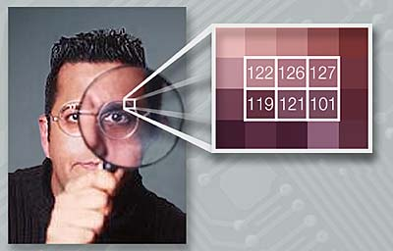
Steganography: The Art of Hiding Data In Plan Sight
A Capstone Project Presentation
By Jonathan Gould

Slide 2

Image #1

Slide 3

Image #2

Slide 4

Image #3

Slide 5

Image #4

Slide 6

Image #5

Slide 7

Image #6

Slide 8

Image #7

Slide 9

Image #8

Slide 10
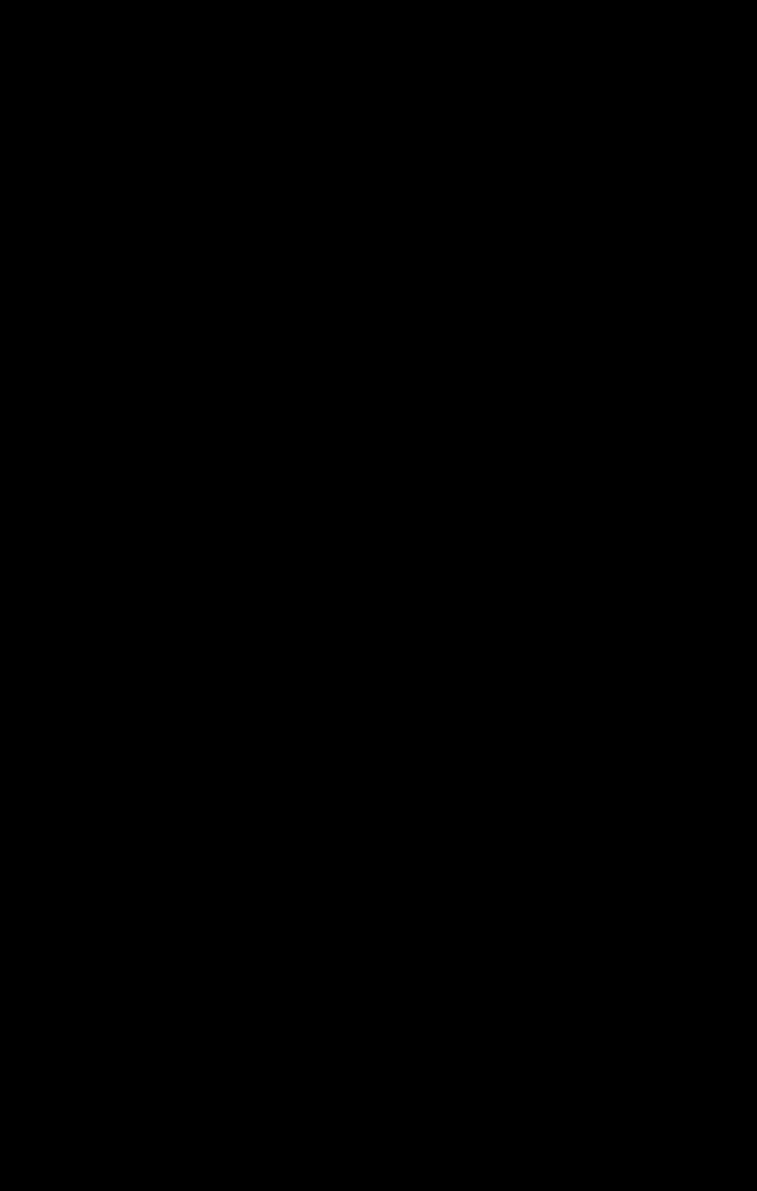
Image #9

Slide 11
How image file formats like .png and .jpg store data
Every pixel's data is stored in three bytes:
  How much red (0-255)
  How much green (0-255)
  How much blue (0-255)
Combined, they form 16 million (2²⁴) colors.
Many of these colors are very similar!

Slide 12


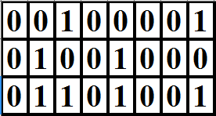
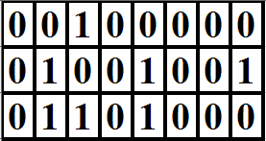
Two different but similar colors
Red = 33
Green = 72
Blue = 105
Red = 32
Green = 73
Blue = 104

Slide 13
Taking Advantage of This
So we can drop a few of the least signficant bits (LSBs) without significantly damaging image quality.
What if we used those bits to hold data? We could use image files to store:
  Text
  Other images
  Audio
  Anything!

Slide 14
My Software
I wrote programs to do the following:
  Remove 1-8 LSB from an image and replace them with zeros, ones, or a random combination of the two.
  Hide either text or an image within another image file, using:
    one, two, or three LSB and
    one of five pixels patterns

Slide 15
My Software (cont.)
  Extract from an image data (image or text) hidden by the previous program.
  Determine whether a given image file is likely to contain text hidden in one of the ways discussed on the previous slide.

Slide 16
Sending Text In Secret
So if two parties had this software:
  One could take private text and encode it in a picture of a cat.
  Upload it to an image-sharing website along with forty-nine other cat pictures.
  The second party runs all fifty through the detection program, finds the right one, and extracts from that image the message.

Slide 17
Brief Demonstration

Slide 18
The Tools I Needed/Learned
How to write reusable code.
How to write flexible code – code that could be used after the addition of new features.
How to write/refactor code to be easily read by others and by myself.
In terms of steganography, my biggest
lesson was ..

Slide 19
Advantage: Hacker
Any manner of obfuscation can work, so long as both parties know the pattern.
There's always a way to further mask data.
There is no good way to stop this technique other than brute-force.

Slide 20
The Risk of Misuse
Conceivably, steganography can be used to:
  Transmit stolen data such as blueprints of government installations
  Leak the technology behind nuclear/chemical/biological weapons
  Disseminate child pornography
  Facilitate any number of illegal activities
So it's bad, right?

Slide 21
Not Always
The same tools used to defeat “good” governments can be used to subvert tyrannical ones.
Steganography can aid those fighting for government transparency (WikiLeaks) or for open access (the late Aaron Swartz).
… so it's good then?

Slide 22
… But thinking makes it so
Steganography: a tool like any other.
Our role is to understand it in theory, to recognize its potency in practice, and to serve as educators for those who do not.

Slide 23
Questions?

Slide 24
Thank you all
for your time
and attention!

